Slide 1

Service Management System
Service Management System (SMS) A full-stack enterprise solution built with ASP.NET Core and Angular to automate the end-to-end service lifecycle. It features JWT security, automated technician scheduling, and LINQ-powered analytics to optimize service delivery and operational efficiency.
Manas Arora
Date- 08/01/26

Slide 2
Project Overview
The Service Management System (SMS) is a comprehensive full-stack solution designed to automate the lifecycle of service-based operations. It transitions manual request handling into a digital ecosystem where Customers can book services, Managers can oversee workloads, and Technicians can manage tasks in real-time.
Technology Stack
Backend: .NET 8 Web API & C#
Frontend: Angular (TypeScript) & Angular Material
Database: SQL Server & Entity Framework Core
Security: JWT (Role-Based Access Control)
Architecture: Layered Architecture with DTOs
Tools: Swagger, Postman, Git

Slide 3
What This Project Solves:
My project digitizes the entire service lifecycle into a single platform:
End-to-End Automation: Automates the flow from Request → Assigned → InProgress → Completed → Closed.
Role-Specific Portals: Provides tailored interfaces for Admins, Managers, Technicians, and Customers.
Data-Driven Insights: Generates real-time dashboards for revenue, workload distribution, and resolution times.
Security & Accuracy: Uses JWT for secure access and DTOs to ensure data integrity across the system.
Key Challenges & Solutions:
Challenge: Protecting sensitive customer and financial data.
Solution: Implemented Role-Based Access Control (RBAC) to ensure users only see data relevant to their role.
Challenge: Accurate billing across different service categories.
Solution: Developed an automated billing service that links Category-specific Base Charges to the final invoice, eliminating manual calculation errors.

Slide 4
Solution & Key Features
🎯 Feature 1
⚡ Feature 2
Role-Based Dashboards Real-time analytics tracking technician workloads, monthly revenue, and resolution metrics via LINQ aggregations.
End-to-End Service Lifecycle Automated tracking from customer request and manager assignment to real-time technician status updates.
🔒 Feature 3
📊 Feature 4
Automated Billing & Invoicing Instant generation of digital invoices based on service category base charges and task priority levels.
Secure JWT Authentication Robust Role-Based Access Control (RBAC) ensuring data privacy and authorized endpoint access for all users.

Slide 5
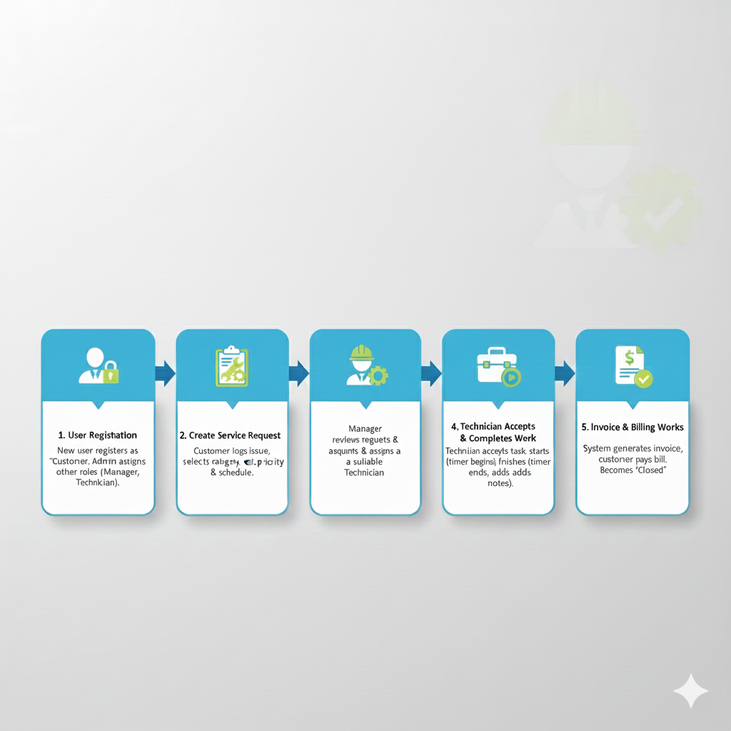
WorkFlow

Slide 6
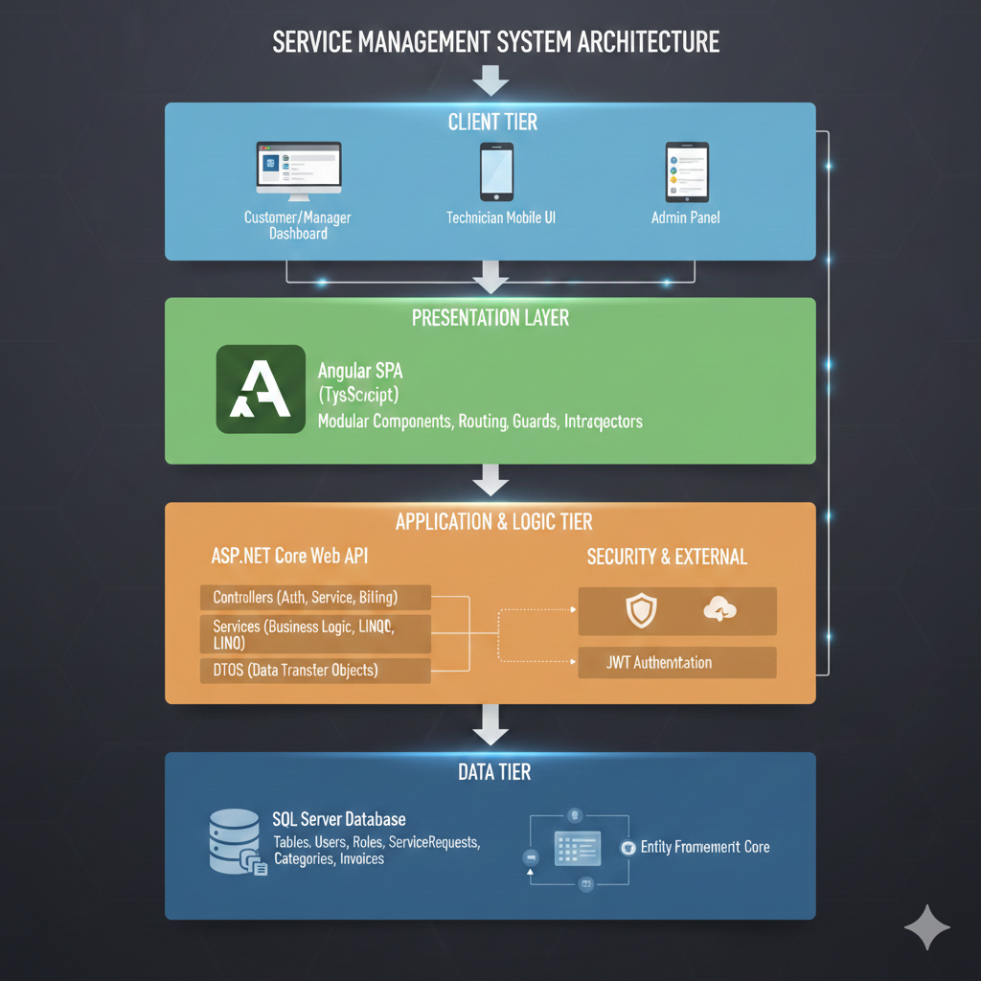
System Architecture

Slide 7
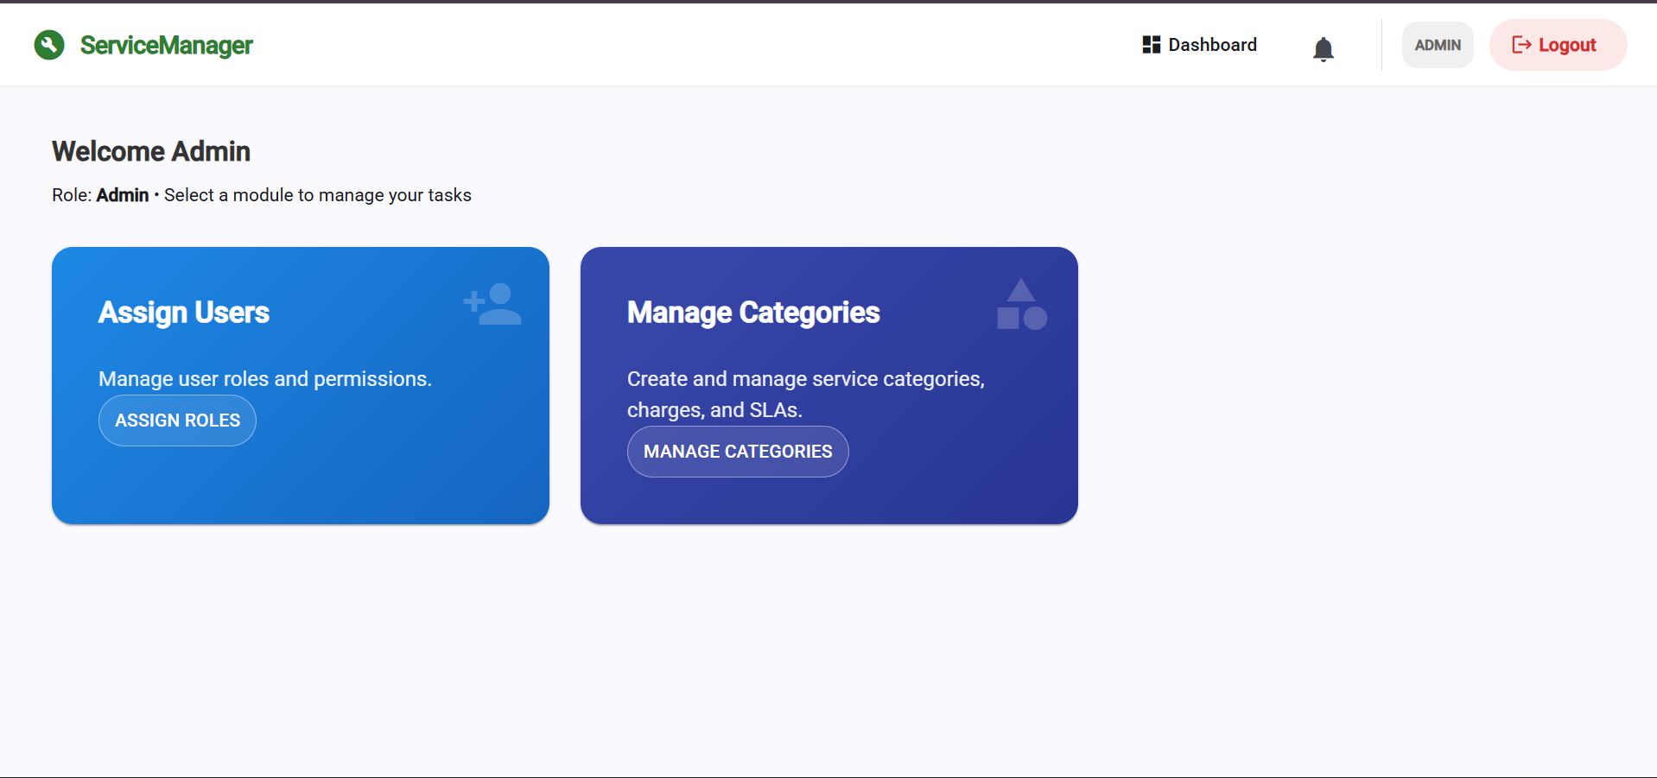
Admin Dashboard Screen

Slide 8
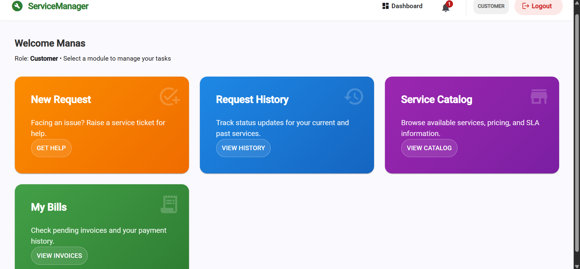
User Dashboard Screen

Slide 9
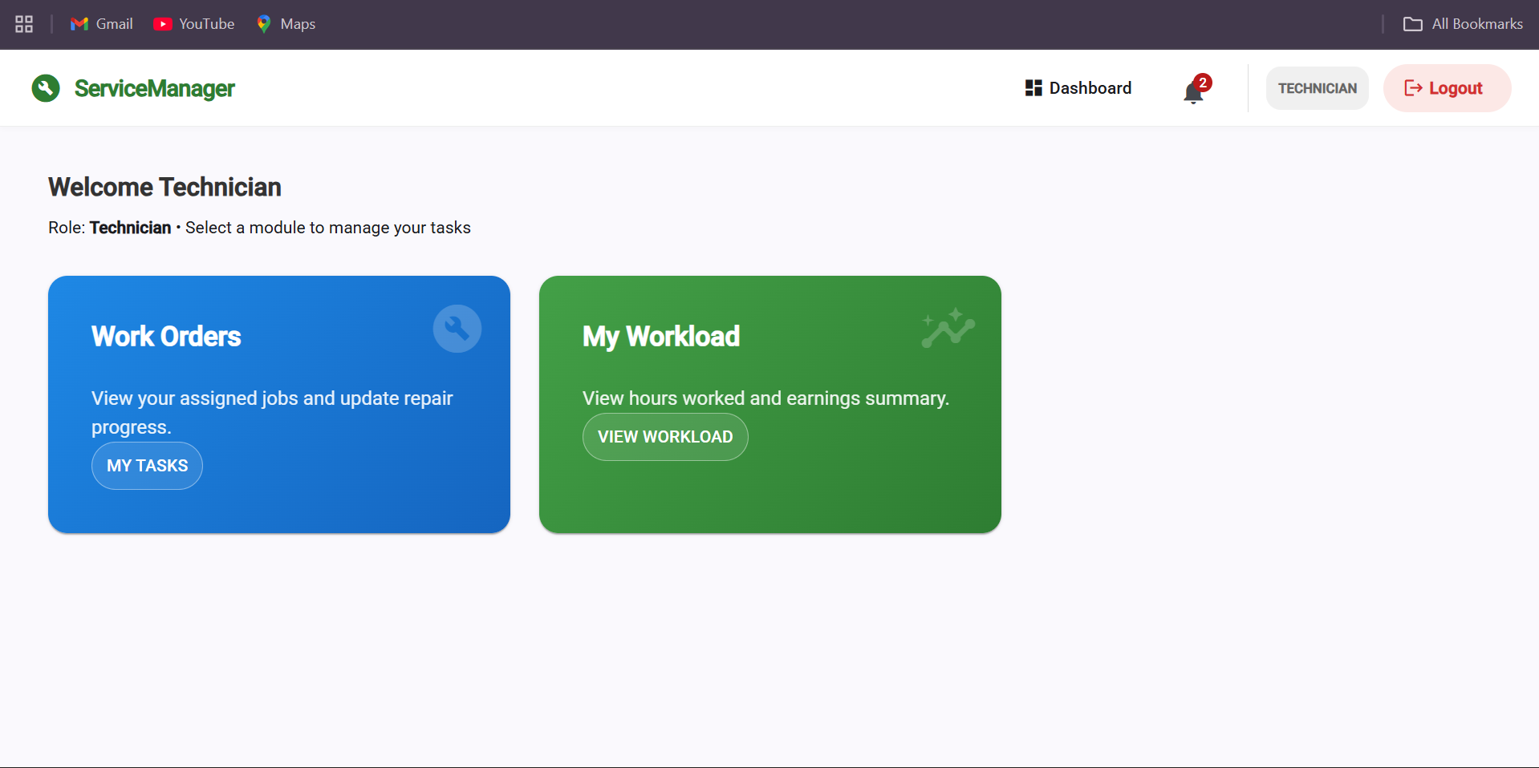
Technician Dashboard Screen

Slide 10
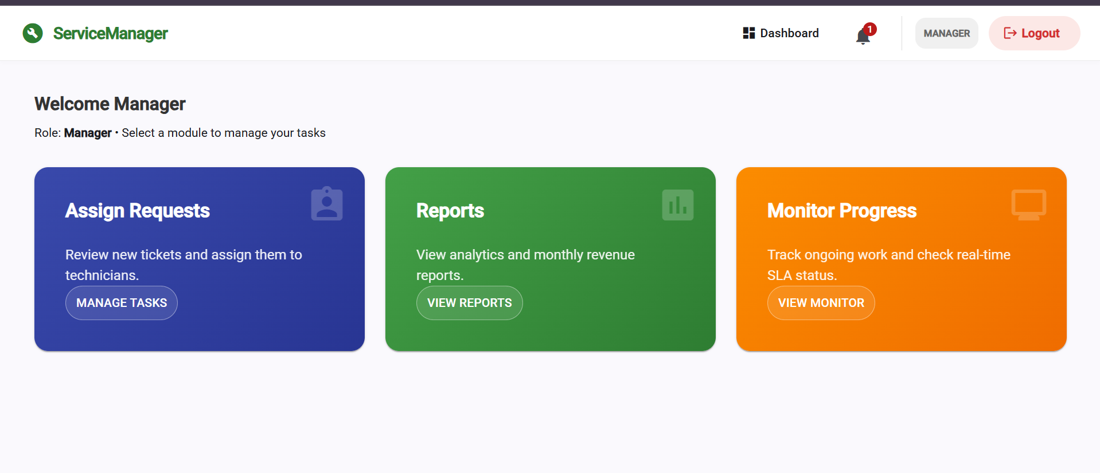
Manager Dashboard Screen

Slide 11
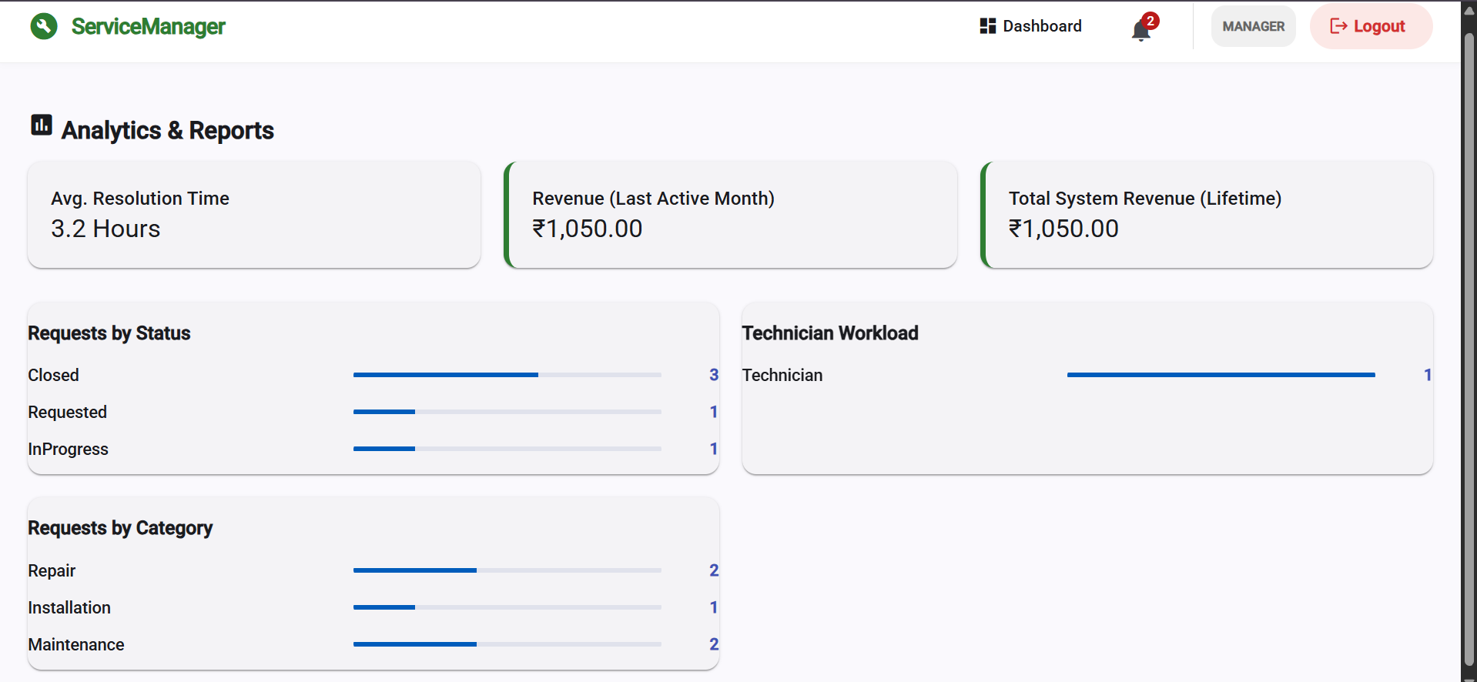
Reports & Analytics

Slide 12
Results & Achievements
Dynamic Business Logic: Engineered an automated Service Lifecycle state machine that manages transitions from Requested to Closed with real-time status tracking.
High-Performance Reporting: Leveraged LINQ Projections to aggregate complex data (Revenue, Technician Workload, and SLAs) directly at the database level.
Efficient Search & Discovery: Integrated server-side Pagination and Filtering, significantly reducing frontend memory overhead for large service request datasets.
Scalable Billing System: Automated invoice generation by linking category-specific base charges and service priority levels for error-free financial tracking.
Seamless RBAC Integration: Successfully mapped Identity Roles to API permissions, ensuring secure access to Manager and Admin dashboard features.

Slide 13
Live Demonstration
Live Demonstration
See the application in action
▶️

